Slide 1
Analysis of RF Circuit Degradation to Ensure Circuit Security
Amanda Thart, Doohwang Chang, Jennifer N. Kitchen, Sule OZEv
School of Electrical, Computer and Energy Engineering

Slide 2
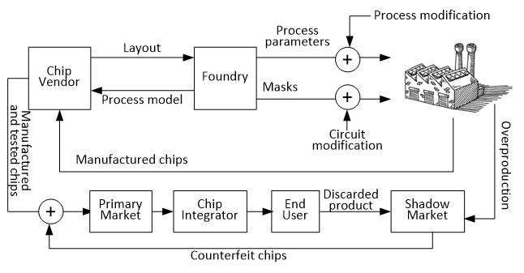
Background
RF components degrade as they age.
The degradation pattern is unique for each circuit design.
Security threats can be introduced with malicious intent to affect the reliability of the product.
Threats can be introduced at: manufacturing plant, design house, or shadow market.

Slide 3
Project Need and Goals
When a security threat is introduced, initially results are consistent with expected values.
Overtime, the alterations will cause a decrease in reliability.
Currently, the government (e.g. NASA, DoD, DoE) perform a long vetting process with companies when outsourcing product manufacturing.
The goal of this project is to develop a test process to verify the long term reliability of circuits, and detect if circuits have been maliciously modified.

Slide 4
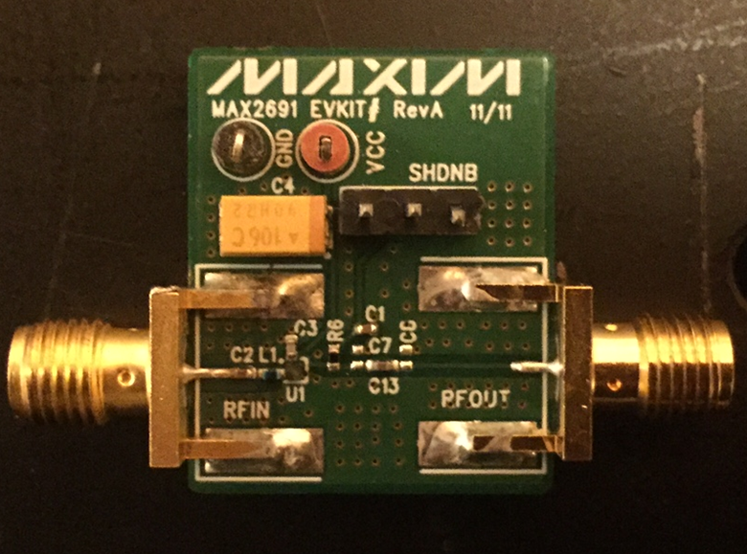
Theory and Technology
Analyze degradation pattern on an original RF circuit and the same circuit that contains a security threat.
Cyclic process of stressing circuit parameters used to mimic aging.
First tests performed with a low noise amplifier.
Circuit Parameter | Value
Supply Voltage | +1.6V to +3.6V
Supply Current | 4.3 mA
Power Gain | 17.5 dB
Temperature | -40°C to +85°C

Slide 5
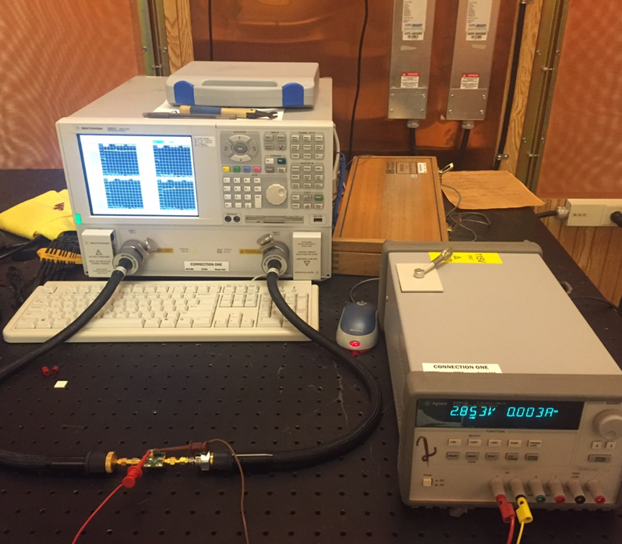
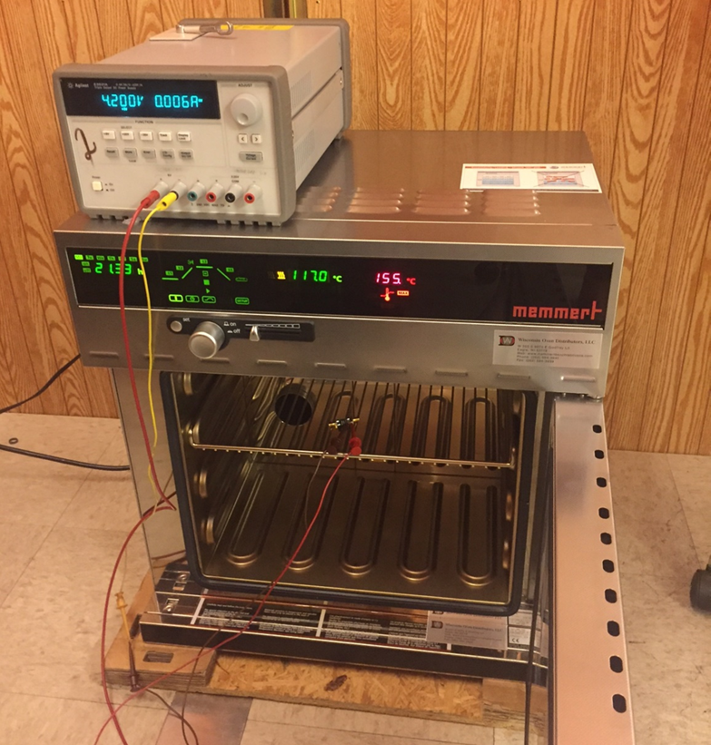
Experimentation Method
The LNA board is connected to a network analyzer and the S- parameters are measured at the lowest, highest, and nominal input voltages.
The board is stressed for 24 hours by running a 4.2V supply voltage and heating at 125 ºC.

Slide 6
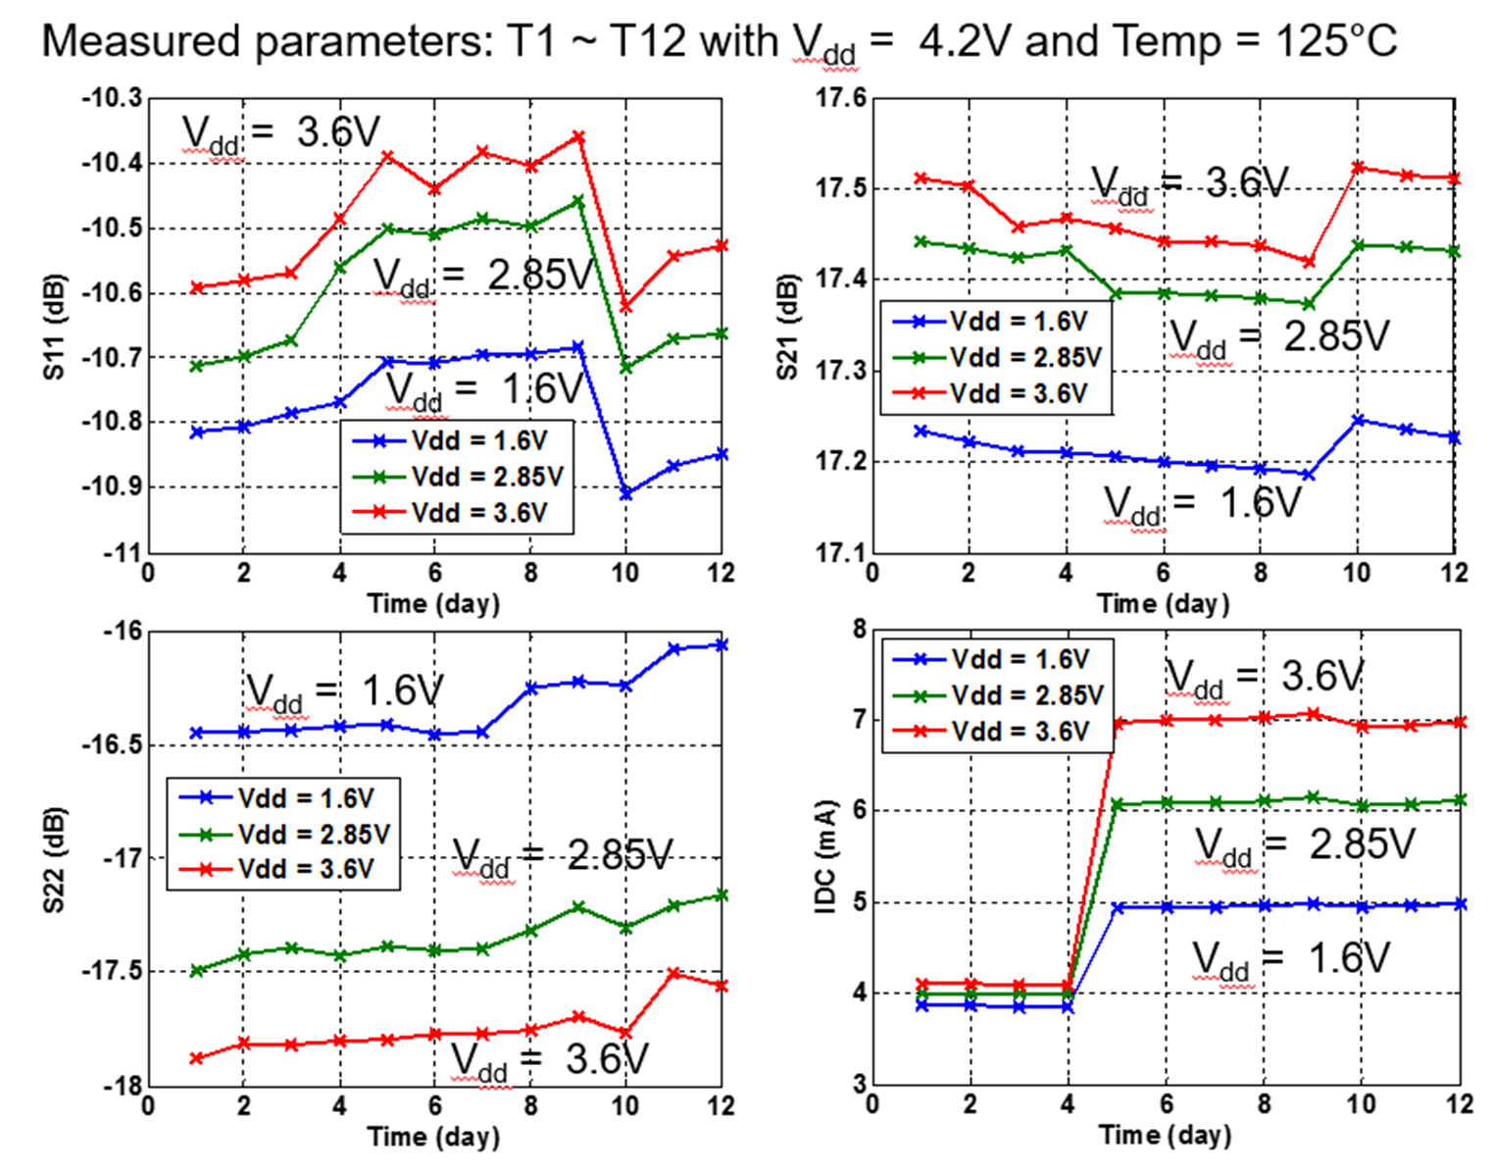
Results
We have tested the original LNA circuit and produced an expected degradation pattern of the S-parameters.
Currently, we are repeating the process with an unchanged oscillator and measuring the frequency, output power, and phase noise.
By repeating the tests on different RF circuits, we are verifying that this testing method can be used on different RF products.

Slide 7
Conclusion and Future Work
Currently, we are completing the tests to find the degradation pattern for the two RF circuits in their original form.
Next, we plan on altering both circuits and repeating the measurements.
Then comparisons will be made between patterns of the original and altered circuits.
Circuit Parameter | Value
Supply Voltage (nominal/stressed) | 1.8V / 2.2V
Temperature (nominal/stressed) | 55°C/ 120°C
Oscillation Frequency | 5.045 GHz
Phase Noise at 1MHz | -119.5 dBc/Hz

Slide 8
Special Thank you to…
Doohwang Chang, MS
Jennifer N. Kitchen, PhD
Sule Ozev, PhD

Slide 9
Questions?

